Slide 1
Technical Support (420-1N6-AB) How to Approach Assignment 4
Fall 2021

Slide 2
Preamble (Assignment 4: behind the curtains!)
PLANNING
Analyze job skills required.
Analyze the trainees.
Assess the needs of the trainees.
Set training objectives.
PREPARATION
Select and organize training content.
Select training methods, techniques, aids.
Prepare training module.
Decide how to evaluate training.
PRESENTATION
Present training module.
Evaluate the training
PROGRESS
11. Review and revise training process.

Slide 3
Preamble
PLANNING
Analyze job skills required:
Recall networking subjects taught in class
Understand basic concepts of networking for final lab: https://kb.parallels.com/en/4948
Analyze the trainees.
Students, some with zero background in the subject matter
Assess the needs of the trainees.
Visual and audio presentation
Follow up with activity and evaluation
Set training objectives.
Complete review of: how does a machine get an IP Address
PREPARATION
Select and organize training content.
Powerpoint
Quiz
Select training methods, techniques, aids.
See above
Prepare training module.
Done
Decide how to evaluate training.
Short quiz (5 questions)

Slide 4
Technical Support (420-1N6-AB)
How do computers find eachother?
Fall 2021

Slide 5
Outline
How does networking help us connect machines for communication?
Main topics:
Network Addresses
MAC Addresses
IP addresses
Local Area Network
Networks vs. Subnetworks

Slide 6

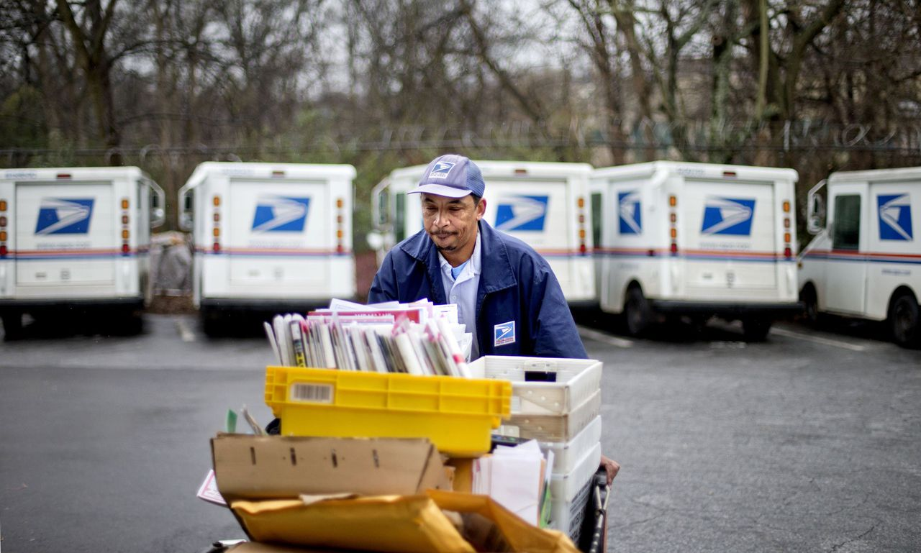


How do we “find” computers?
Just like in physical communication: with an address!

Slide 7
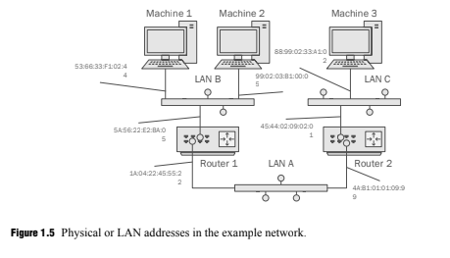
What “Address” do computers have?
Answer: a MAC (machine) address!
Every machine that can connect to a network has a unique machine address assigned to it at creation
Vendors are given a range of MAC Addresses that can be assigned to their products by the IEEE (Institute of Electrical and Electronics Engineers).
These addresses are physically burned into the Network Interface Cards (NICs) that machines use to connect to eachother

Slide 8
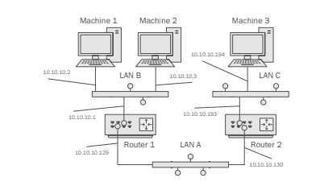
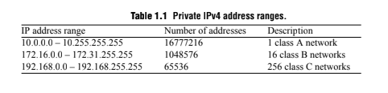
How do we find that address?
Two answers: Private and Public IP addresses
MAC addresses are translated to IP addresses by Routers
Private IP addresses: accessible only within a Local Area Network (LAN)
Public IP addresses: discoverable anywhere on the internet using DNS lookup

Slide 9
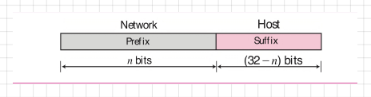
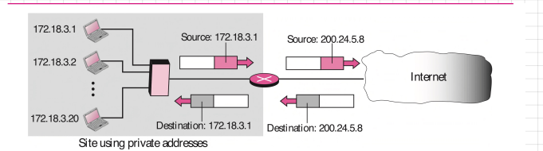
How are addresses organize?
Answer: Networks and Subnetworks

Slide 10
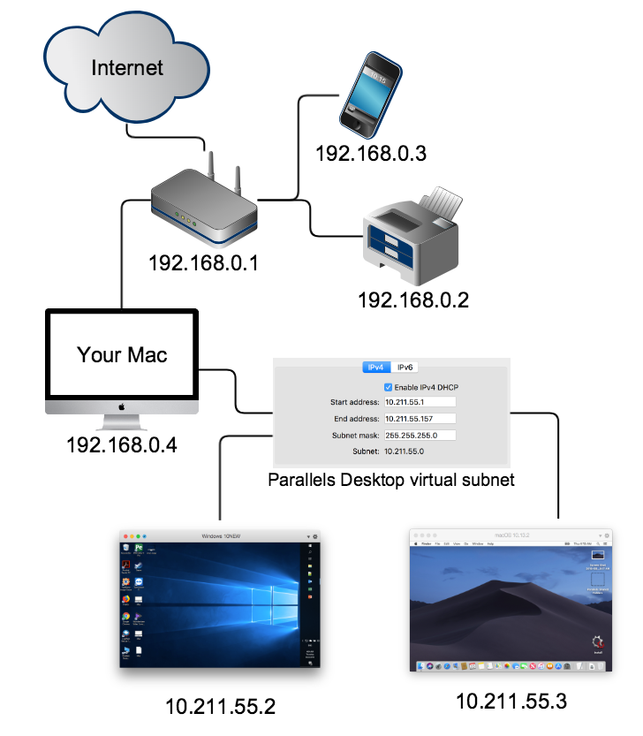
The point: virtual networking!
Tomorrow’s lab:

Slide 11
Q & A
Notes:
In Slide Show mode, click the arrow to enter the PowerPoint Getting Started Center.

Slide 12
Activity
Navigate to “Distributed Documents” on LEA
Pick 3 of the lectures I’ve posted, not including “15 - User Training”
Come up with at least one question for each that you would like answered by whichever group will present on this topic
(you should look at topics you think your group will cover; this will hopefully help you choose between topics you’re considering!)
Write a MIO to me with your 3 questions

